Slide 1
Collaboration TANJA HULST & MANDY DE ROOS

Slide 2
Collaborate during covid
Non-excistence of the physical workplace
Less focus on the inside world
No distance to the outside world
Urgent necessity to innovate for SME’s
A crisis is a chance to do things differently
A crisis accelerates innovation
Notes:
Bron Brainport
Blooming economy to remind

Slide 3
Sonarski case accelerated through collaboration
lidar technology for scanning environments and point cloud technology
Scoping challenges
Network introductions
Providing research capacity
Student’s fresh perspective
Accelerating innovation

Slide 4
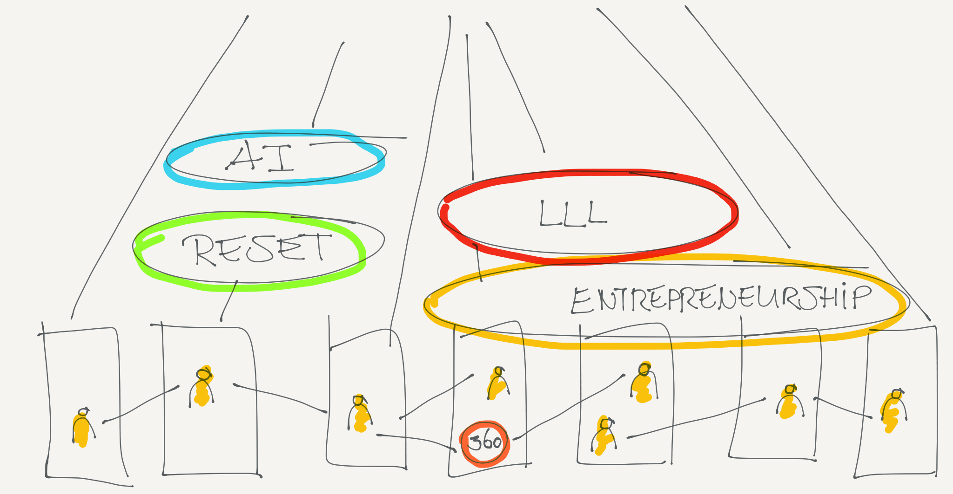
Internal focus working with the outside world

Slide 5
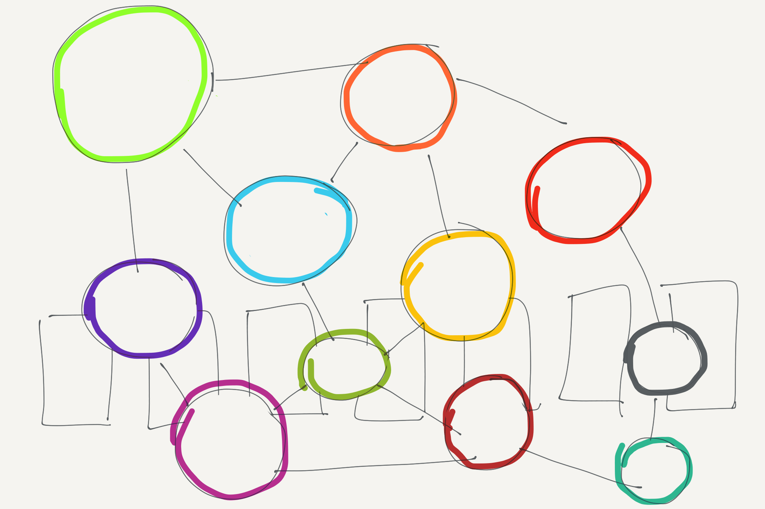
Building a network working together on themes

Slide 6
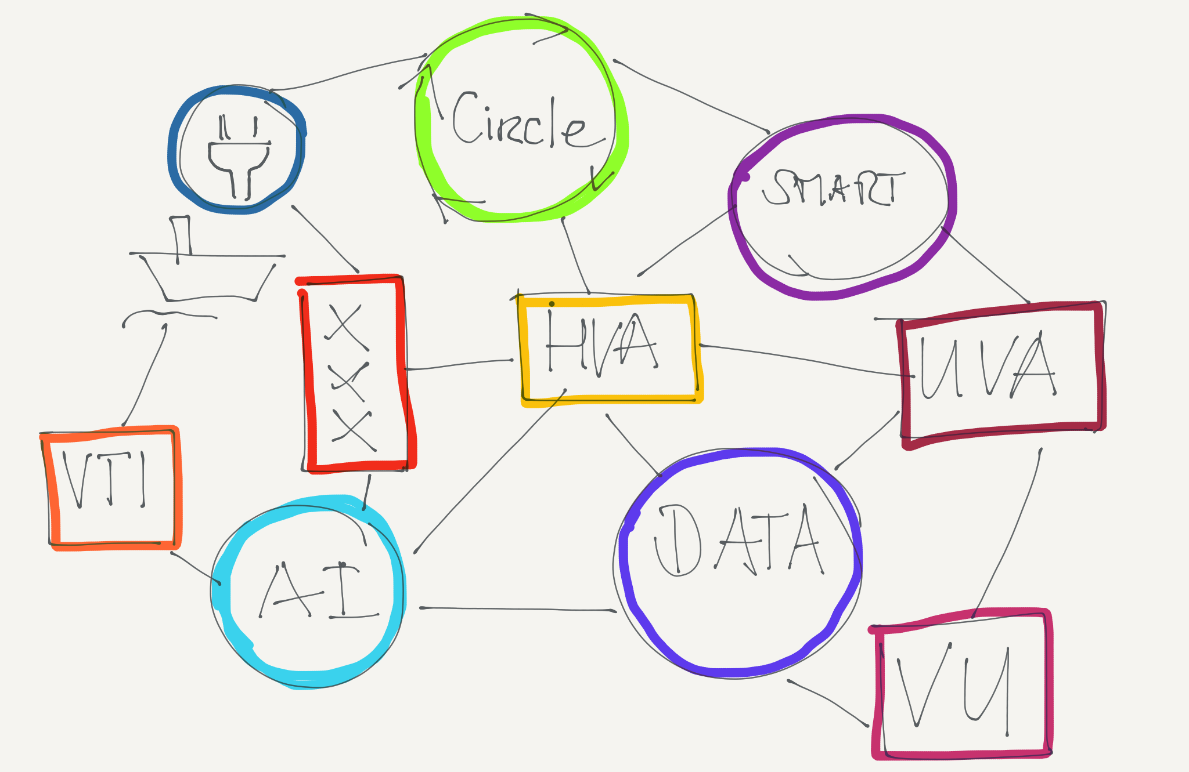
Outside-In collaborative innovation-ecosystem

Slide 7
Innovation-ecosystem innovating with SME’s & government
Connected collaboration
Understanding innovation needs
Visual vision to engage partners
Outward-facing partners
Create a win-win for all partners
Joint orchestration or orchestrator has superior product/service (IP)
Agility & adaptability to respond to new ideas
Notes:
Colleborative versus connected collaboration (Martine de Jong)
Insight mining, behaviour, needs, problems (Unilever background as a brand manager connecting to consumer insights).
Vision to engage about the future as if it is already there, Conceptual thinking, visual thinking
Need for innovation managers, or openminded entrepreneurial counterparts
360 Learning is facilitating the role of the orchestrator by offering help and being humble
Stay flexible and openminded, no hierarchy or closed systems
Participating in an ecosystem requires an outward-facing culture and the ability to manage relationships with a host of complementors. Those skills don’t come easily to established players, which tend to default to one of two approaches: to create a vertically integrated, tightly controlled network, as Nokia did, or to hop on the bandwagon of open innovation and production, providing only a platform and leaving ecosystem management up to users. The risk there is that without some central impetus or incentive from the host, other parties may fail to engage.

Slide 8
Innovation design connected collaboration
INNOVATION DESIGN offers an open mindset to structural problems whilst solving them with the energy and knowledge of a diverse group.
INNOVATIONCOACHES with BROAD MINDSET
Outside-in approach
Designers mindset
Entrepreneurial drive
Connective skills
Notes:
Insight mining, behaviour, needs, problems
Connected collaboration
Talk about the future as if it is already there, Conceptual thinking, visual thinking
Participating in an ecosystem requires an outward-facing culture and the ability to manage relationships with a host of complementors. Those skills don’t come easily to established players, which tend to default to one of two approaches: to create a vertically integrated, tightly controlled network, as Nokia did, or to hop on the bandwagon of open innovation and production, providing only a platform and leaving ecosystem management up to users. The risk there is that without some central impetus or incentive from the host, other parties may fail to engage.
Create a win-win for all partners
Possession of a superior product or service that is hard to replicate.
Agility to respond to new challengers,
Humility to understand customer needs,
Vision to inspire complementors

Slide 9
Innovation designer profile
Leadership skills
Daring attitude; adventurous or audaciously bold
Long-term; think big act small
Broad scope; covering a large number and wide scope of subjects,
Connective skills; understanding essential needs and looking for common ground
Optimistic; facing challenges and being perseverant

Slide 10
Collaboration innovating with SME’s & government
Think big and start small
Start quick without money
Look for a joint funding strategy
Notes:
Looking for innovations which are inclusive for all our stakeholders we move to a Multi Helix model incorporating not only government, business and education but also including citizens, investors, ngo’s, corporations and students.
To be the orchestrator and prime mover of an ecosystem, you need a superior product or service that is hard to replicate. This means some combination of IP protection, a large network of users, and strong branding. HBR Michael G. Jacobides
This chapter summarizes the evolution of the metaphorical concept of the triple helix, through the quadruple helix and quintuple helix; the second Leydesdorff (J Knowl Econ 3(1):25–35, 2012), a founder of Triple Helix, invites the submission of other model proposals with more than three helices. Based on the literature review on these currents of collaborative interaction for innovation, knowledge and technology transfer, we set out to build a conceptual model that can help explain the improvement of sustainable competitiveness of economies and companies. The model has been designed from the concept of “Multiple Helix Ecosystems for Sustainable Competitiveness”, opening doors to its empirical verification.

Slide 11
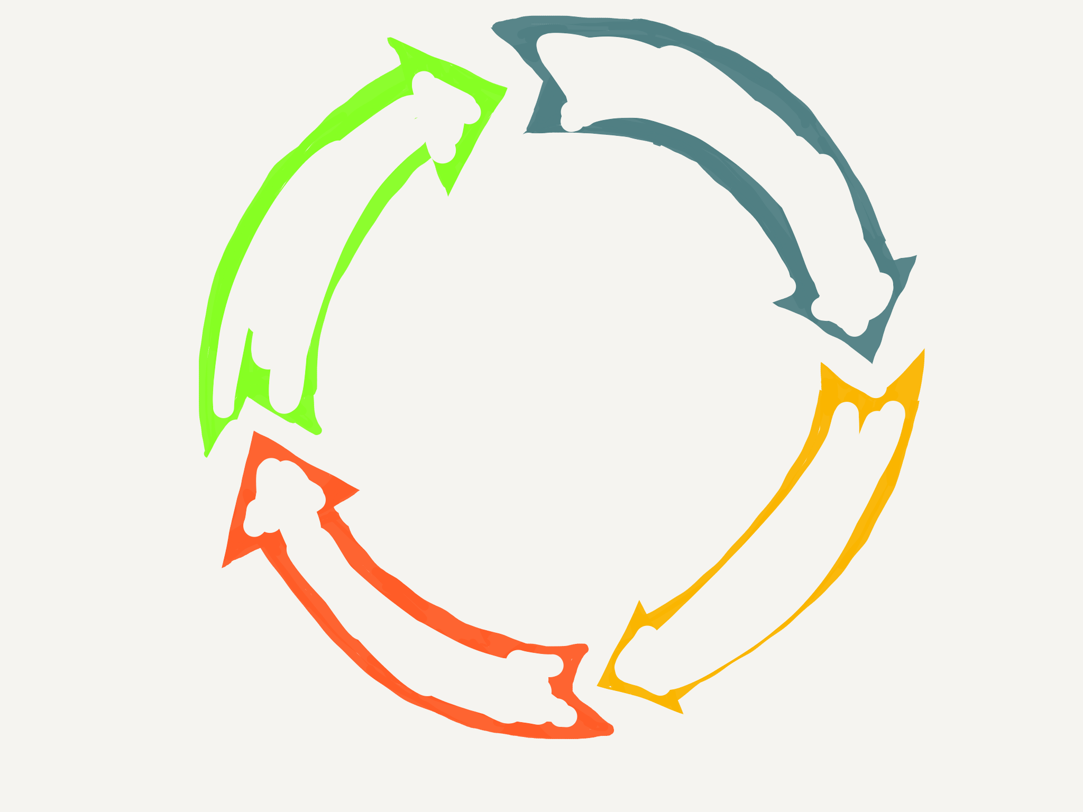
meet ∙ explore ∙ team ∙ trust 4 steps to COLLABORATION
EXPLORE
MEET
TEAM
TRUST

Slide 12
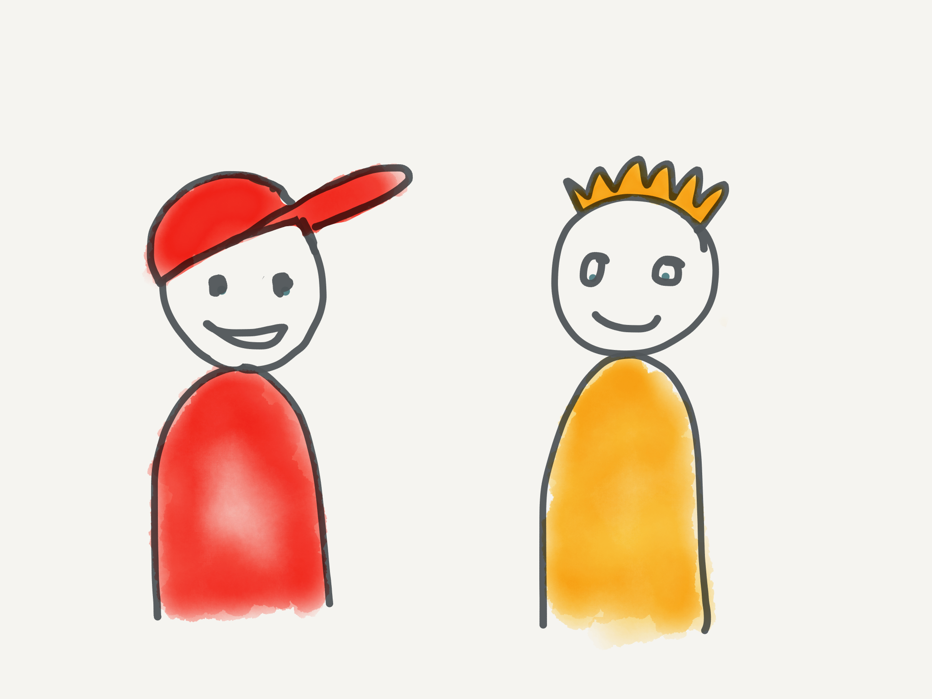
MEET CONNECT TO PEOPLE
Network events
Find mutual interests
Engage
Offer your network

Slide 13
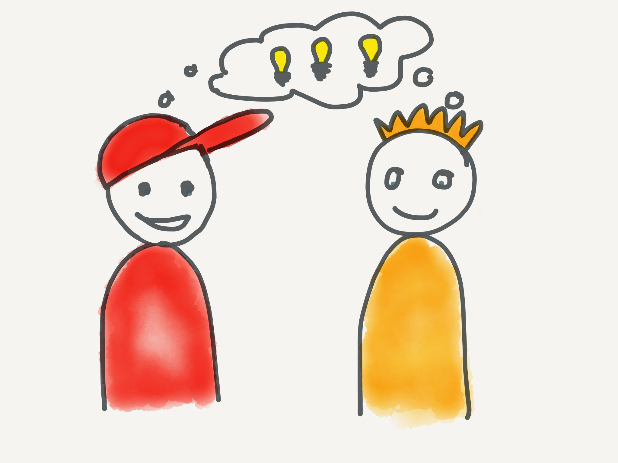
EXPLORE built - measure - learn
Start doing
Design sprints
Room for failure
Learn by doing

Slide 14
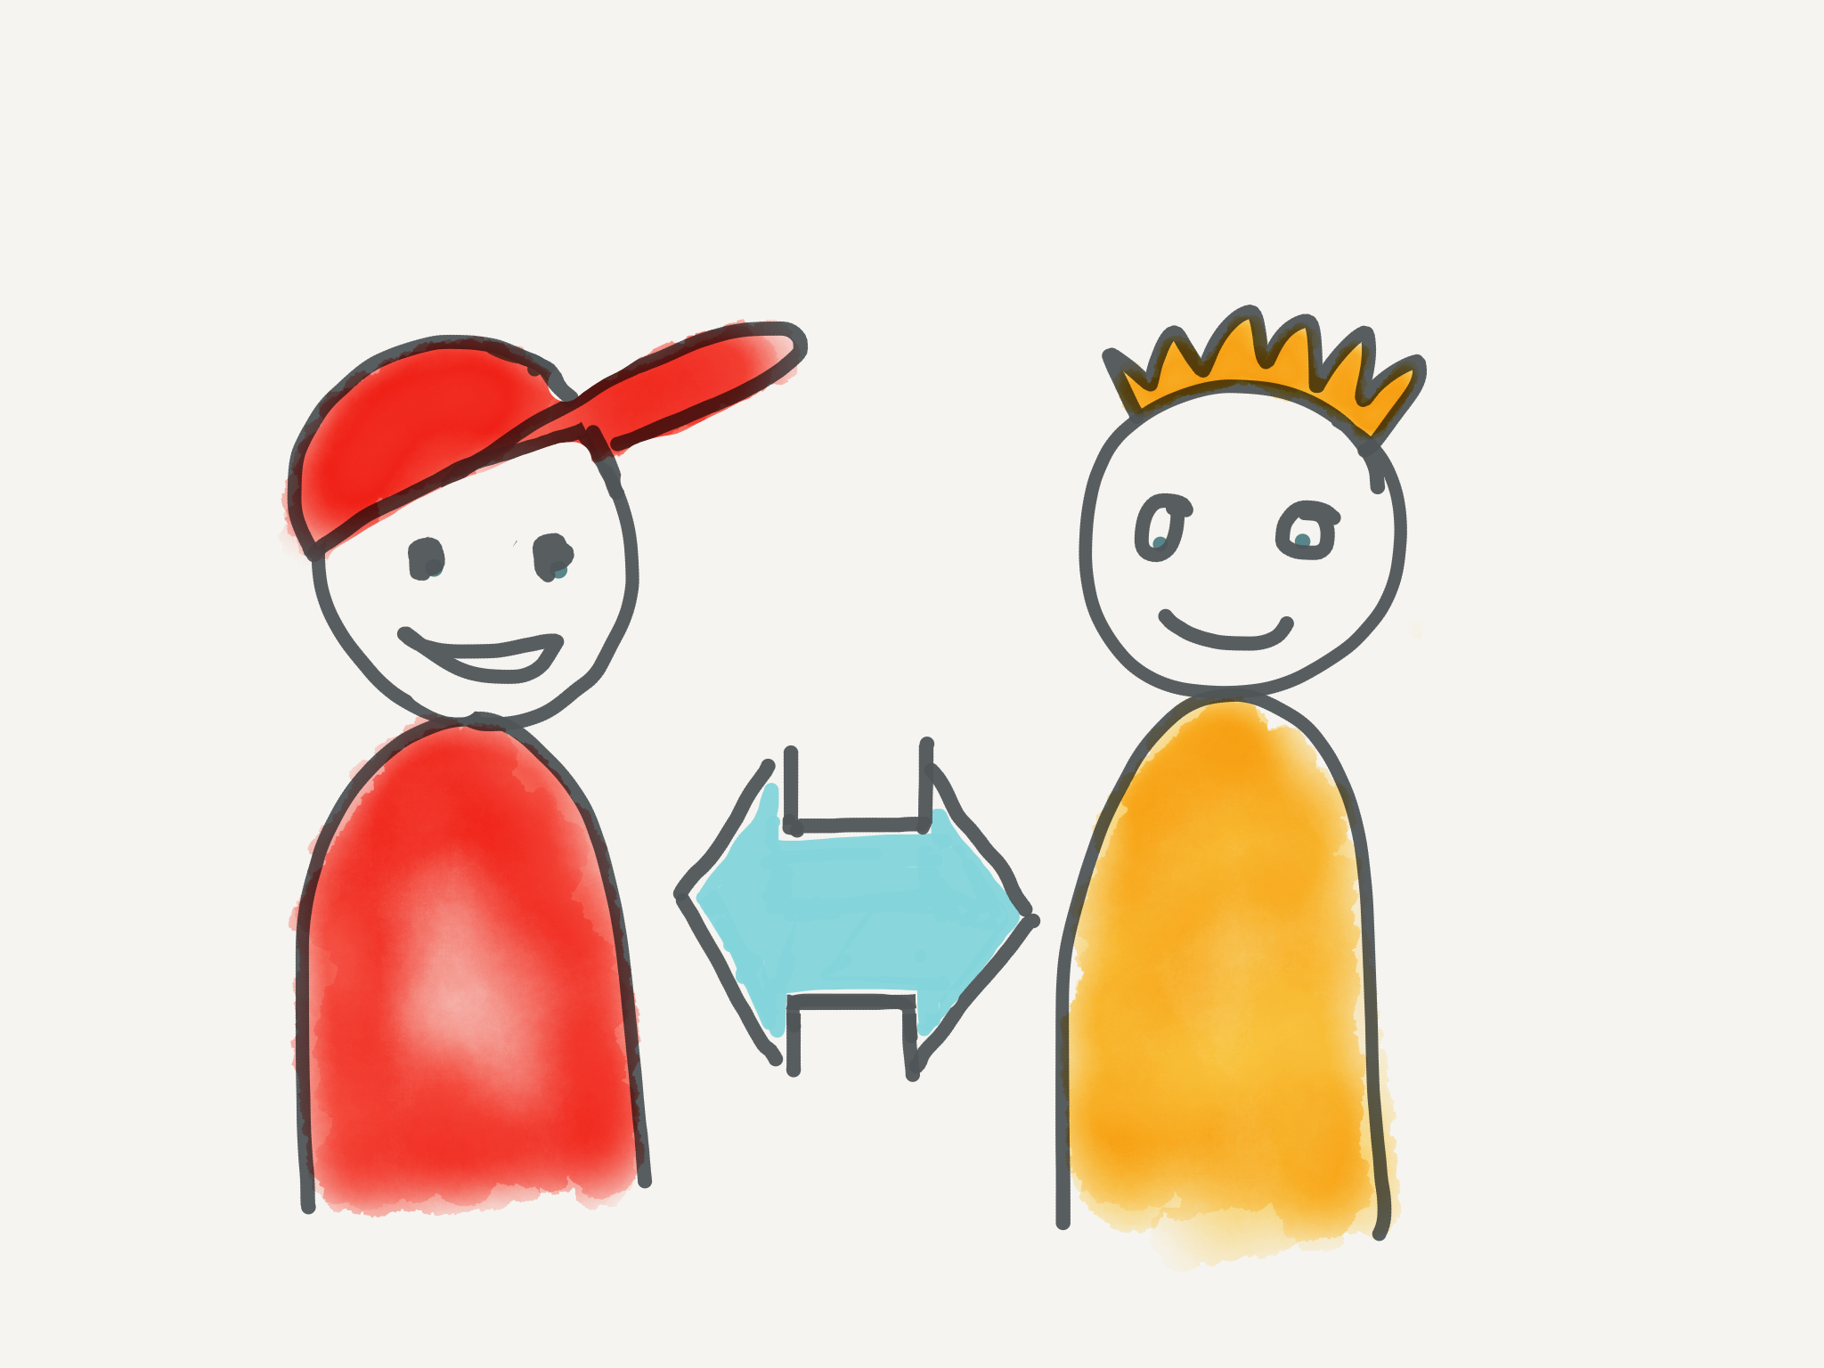
TEAM COLLABORATE
Be connected
Build experiences
Work hard
Bond

Slide 15
Trust GROW CLOSER
Joint ownership
Share audacious goals
Learn together
Fail together

Slide 16
KEEP MEETING CONNECT TO PEOPLE
Keep networking
Adapt to new ideas
Engage others
Offer your network

Slide 17
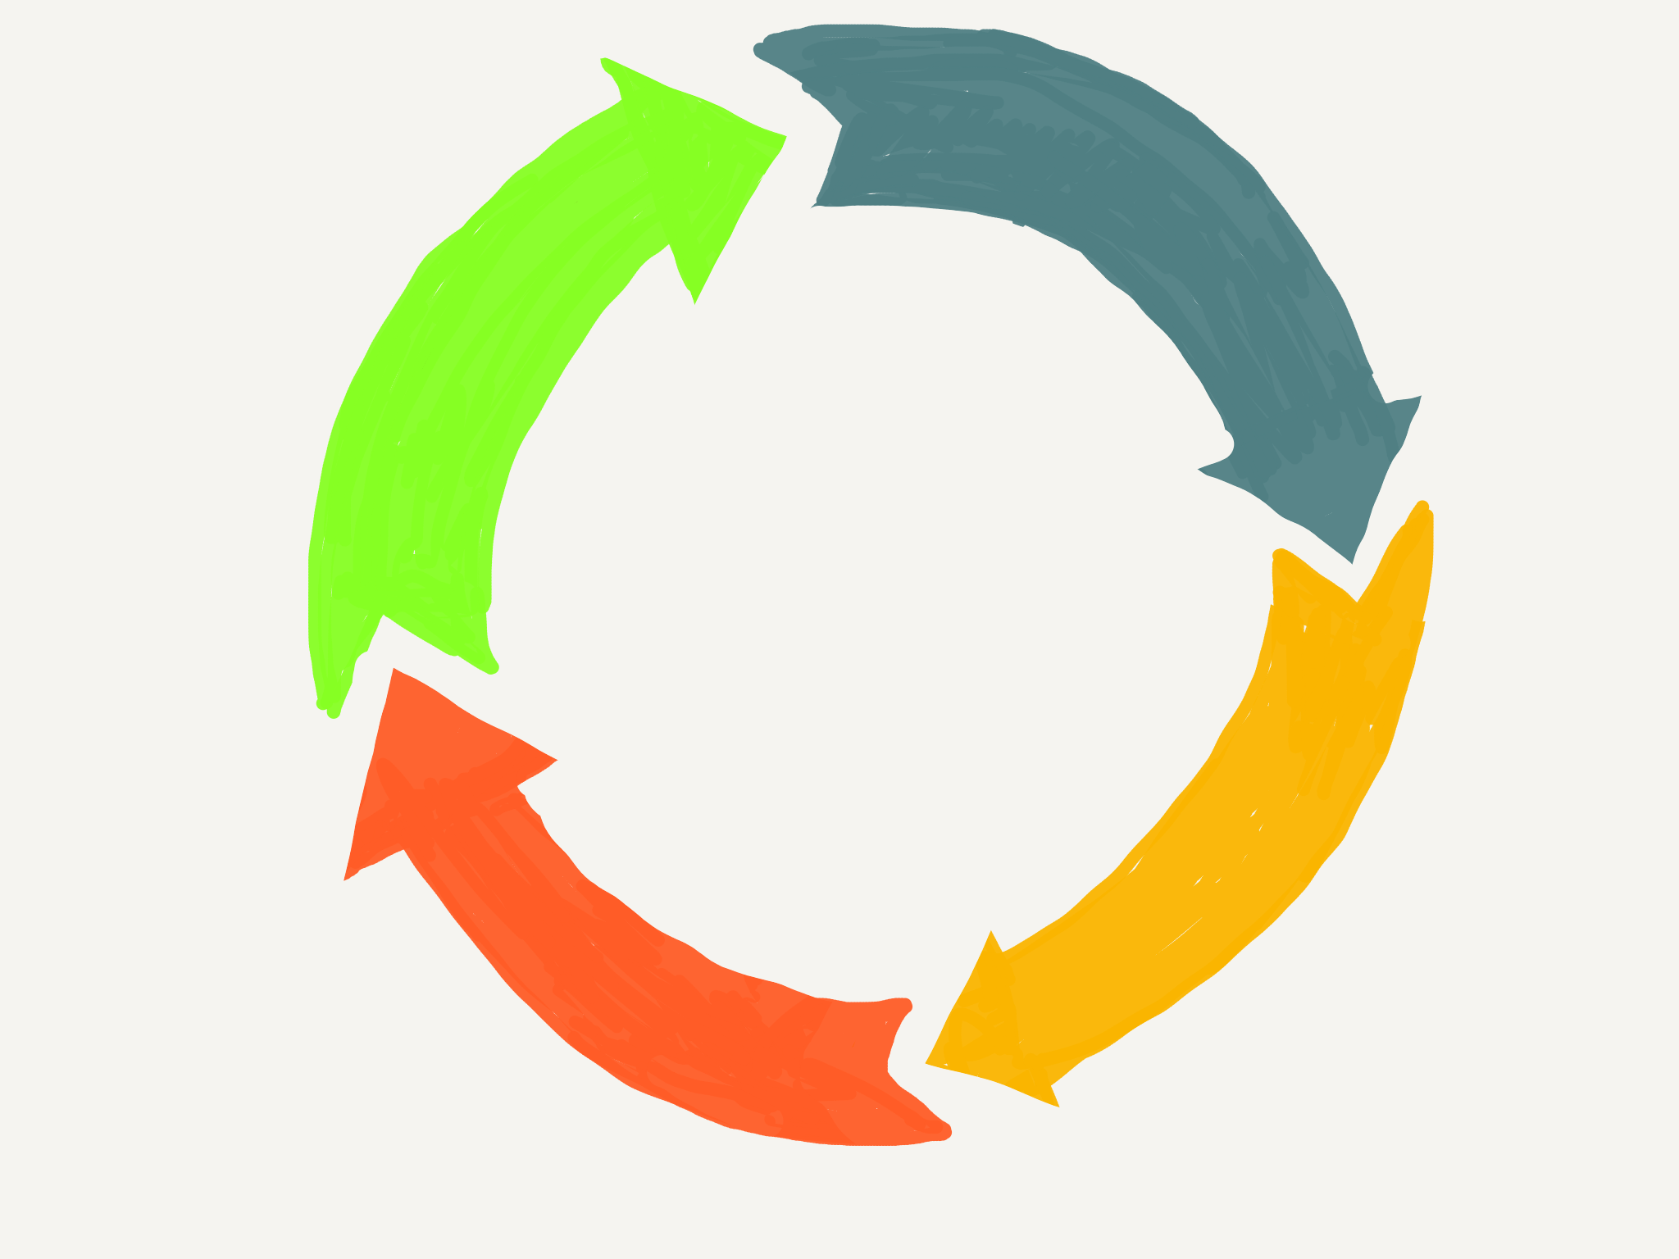
CONTINUOUS LOOP OPEN MINDSET
Notes:
Looking for innovations which are inclusive for all our stakeholders we move to a Multi Helix model incorporating not only government, business and education but also including citizens, investors, ngo’s, corporations and students.
To be the orchestrator and prime mover of an ecosystem, you need a superior product or service that is hard to replicate. This means some combination of IP protection, a large network of users, and strong branding. HBR Michael G. Jacobides
This chapter summarizes the evolution of the metaphorical concept of the triple helix, through the quadruple helix and quintuple helix; the second Leydesdorff (J Knowl Econ 3(1):25–35, 2012), a founder of Triple Helix, invites the submission of other model proposals with more than three helices. Based on the literature review on these currents of collaborative interaction for innovation, knowledge and technology transfer, we set out to build a conceptual model that can help explain the improvement of sustainable competitiveness of economies and companies. The model has been designed from the concept of “Multiple Helix Ecosystems for Sustainable Competitiveness”, opening doors to its empirical verification.

Slide 18
Collaboration TANJA HULST & MANDY DE ROOS

Slide 19
contributors
Rabobank
MKB Digital Workspace
ABN AMRO Bank N.V.
PIM Noord – Holland
Innovatiefonds Province Noord-Holland
IXA
HighTech NL*
Deloitte*
Techniek NL*

Slide 20
Ecosystem connect people & knowledge
a system, or a group of interconnected elements, formed by the interaction of a community of organisms with their environment.
Notes:
ecosystem-focused framework, as opposed to a firm-focused one
Elements needed to create an ecosystem
Create a win-win for all partners
Possession of a superior product or service that is hard to replicate. (This means some combination of IP protection, a large network of users, and strong branding).
agility to respond to new challengers,
humility to understand customer needs,
vision to inspire complementors

Slide 21
communication engage others
Talk about the future as if it is here
Visualisations to engage partners
Notes:
Talk about the future as if it is here
Visualisations to engage partners

