Slide 1
Workshop

Slide 2
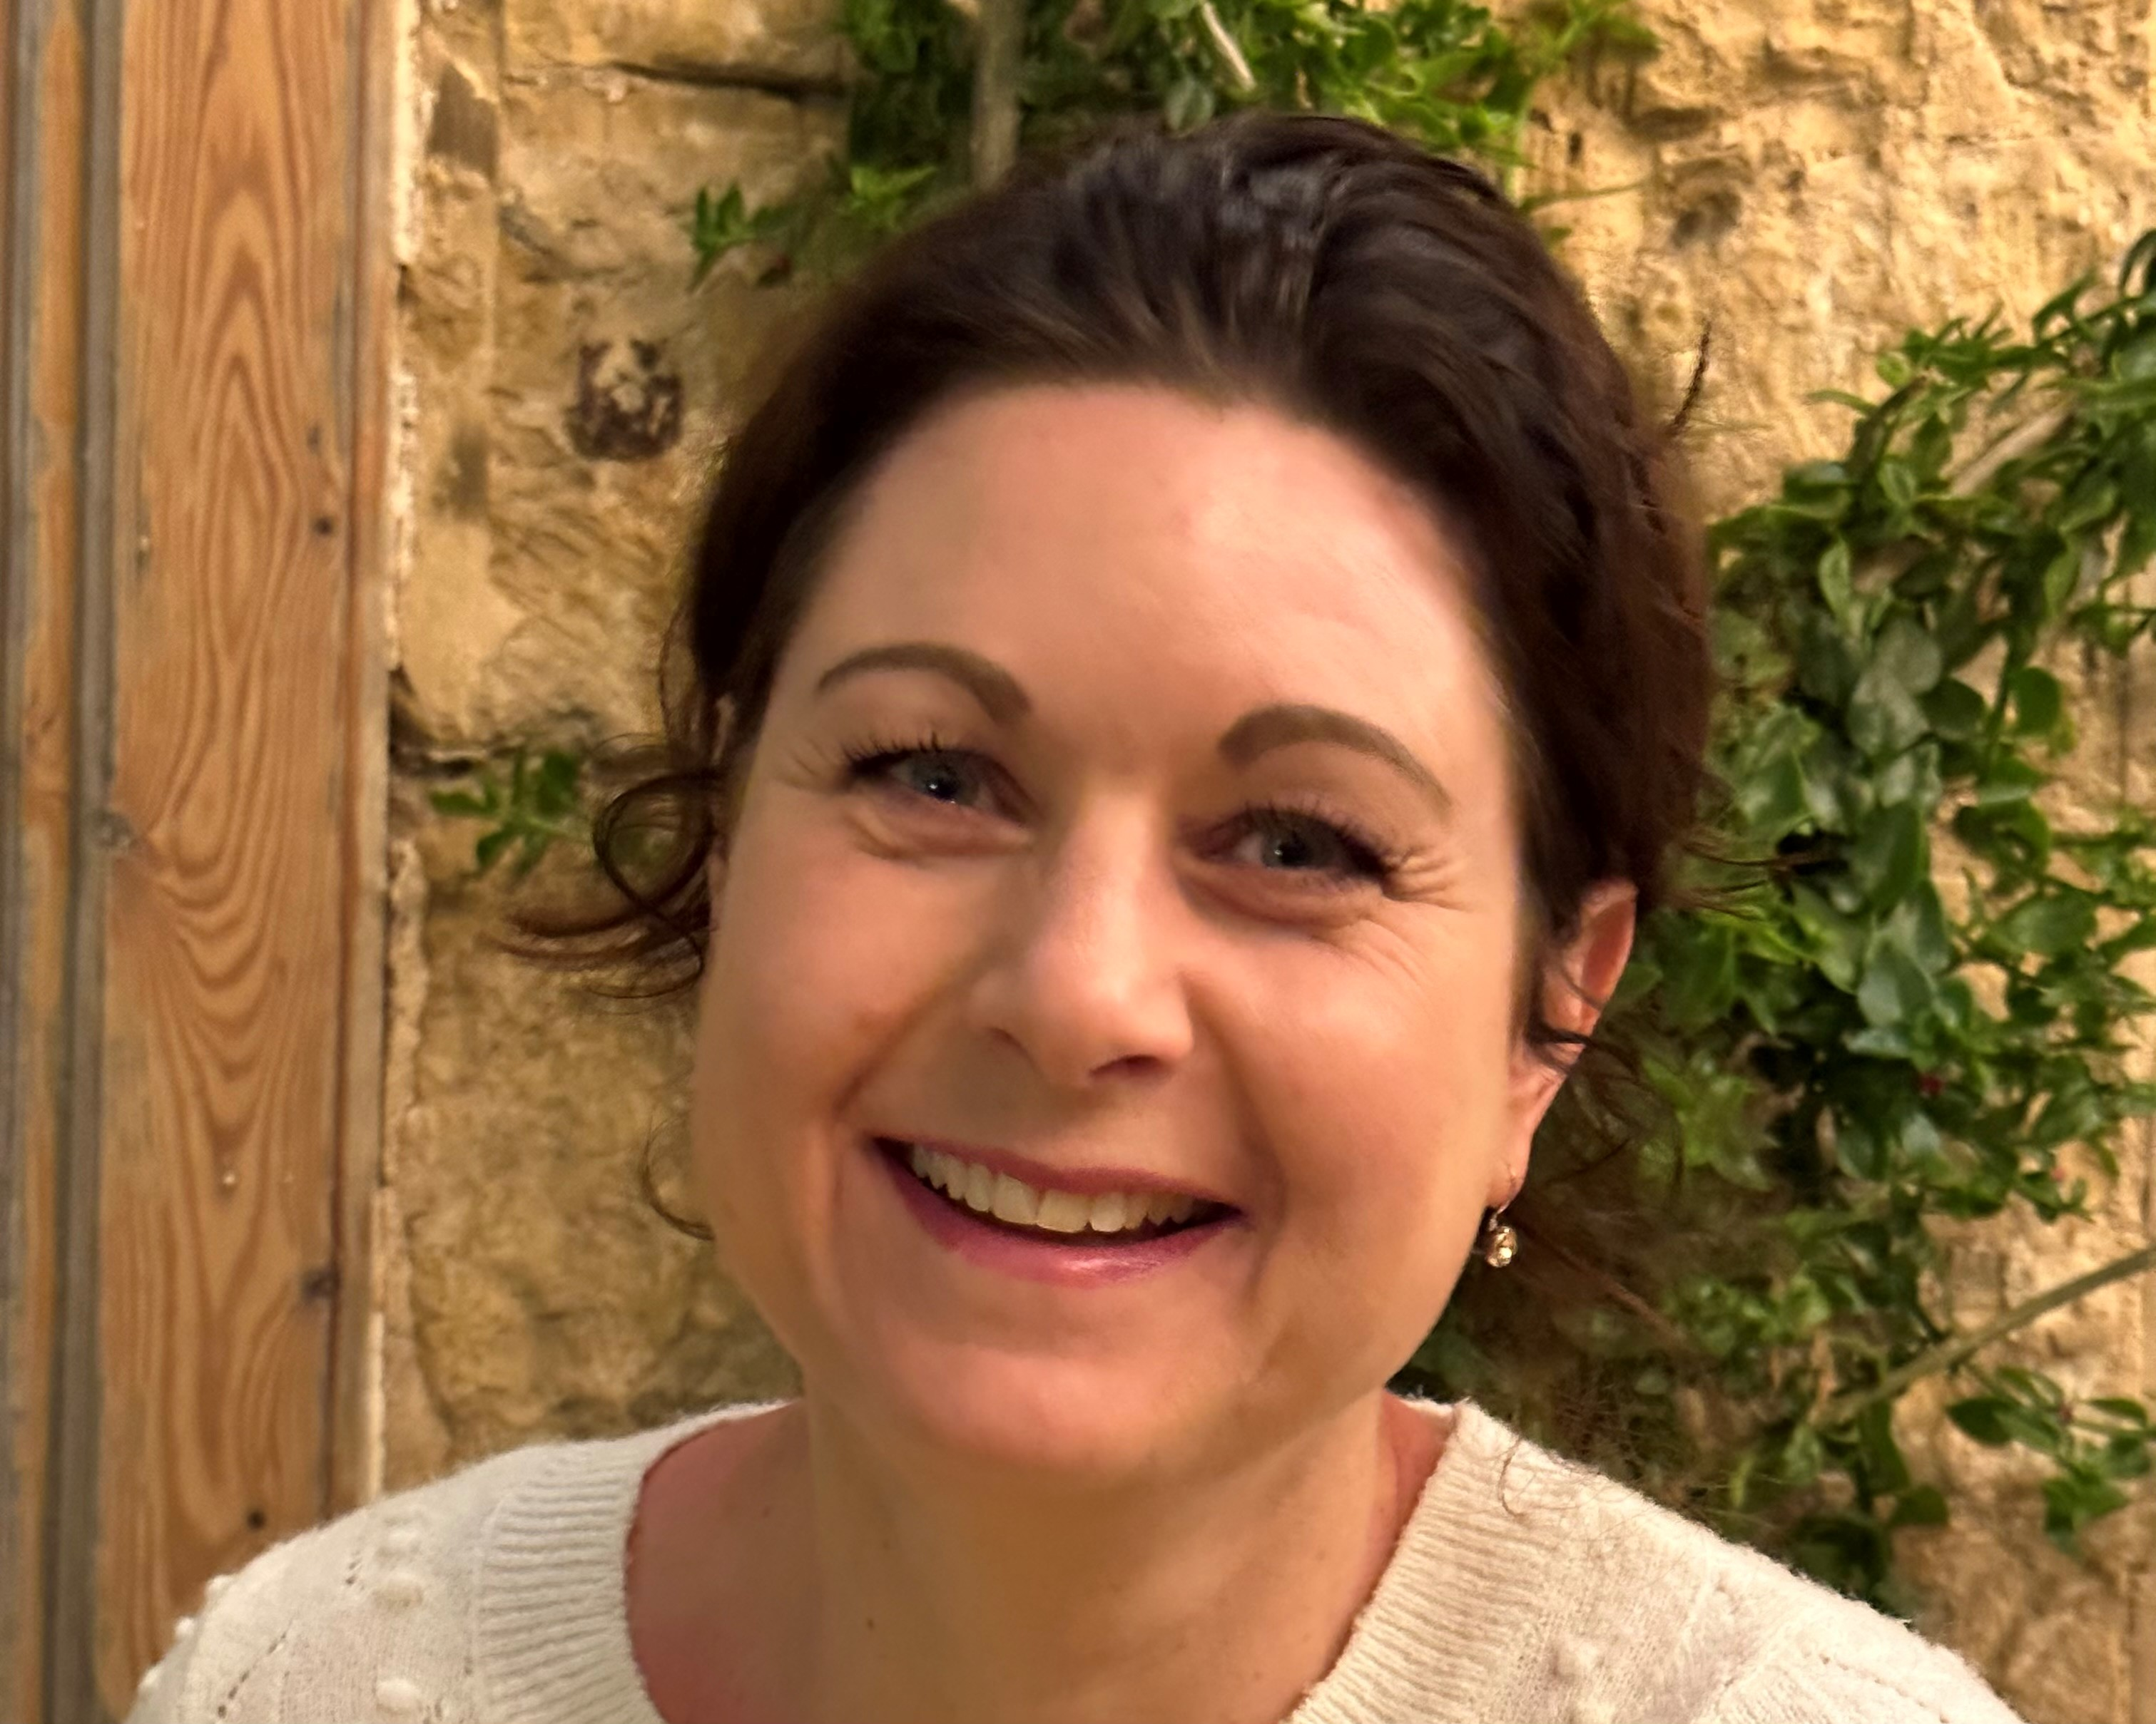
Introductie
Dr. Peggy Lambriex
Passie voor Onderwijs / Leren en Ontwikkelen /
Veranderen
Verschillende rollen
Mijn superkracht
Notes:
My name is P.L. and I'm really passionate about education, especcially about implementing innovations in a sustainable way. I work at Zuyd University as a senior researcher and beside that I'm the director of the academy of Speech therapy, A Bachelor Programma in the Netherlands.
Over the years I have had many different roles, starting as a health professional. After that I became a teacher and the last few years working as a manager and Educational scientist in the field of "sustainable implementation and innovation in education".
My superpower is to motivate and stimulate people to learn and develop and to let them fly even higher.
Making people believe in themselves, try, fail and learn to become the best version of themselves
Every individual has the potential to be extraordinary, to be great. But to realize this potential, one needs to be fueled by positive energies, inspired actions, and uplifting conversations. To become great, one must surround oneself with greatness, with people whose visions align with theirs, whose ambitions resonate with their own.

Slide 3
Agenda
Introductie
Theorie
IWB tool
Take home
Vragenlijst
Follow up
Notes:
Today we are going to unravel innovative work behavior and take the first step forward to sustainable innovations.
This session is divided into 6 parts. First I want to hear about your superpower in our introduction. Second I will give a short overview of the theory. After that there is room to fill out the questionnaire and to discuss the results. Fourth we are going to analyze own practice with a IWB tool and formulate first steps to overcome implementation difficulties. Fifth, there is a wrap up and I'm interested in your take home message and Finally we make arrangements for the follow up.

Slide 4
Korte introductie Deelnemers workshop
This Photo by Unknown author is licensed under CC BY-SA-NC.
Notes:
Check aantal vanwege introductie
Kleine groep elke deelnemer vragen naar zijn superpower naam en rol en land/ plek
I want to know what your superpower is. Where are you from and what is your role?

Slide 5
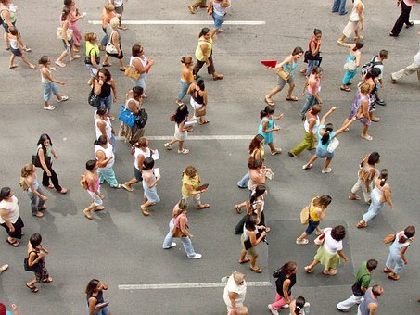
Notes:
Our current society demands a lot from all of us. There is a rapid development of new knowledge and technological advancements that are happening incredibly fast.

Slide 6
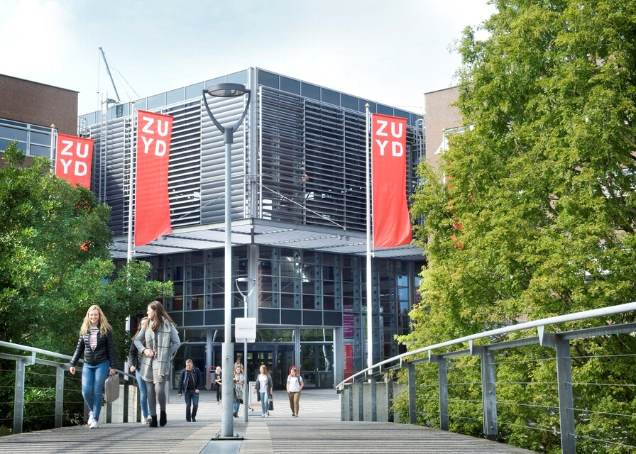
Notes:
This has consequences for the way we educate our youth. Vocational education aims to prepare young individuals for the demands of society, which is abviously changing rapidly. Teachers and educational institutions are constantly bombarded with new ideas and scientific insights that should be incorporated into lessons and educational programs.

Slide 7
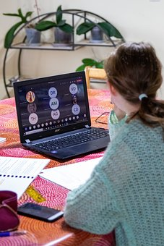
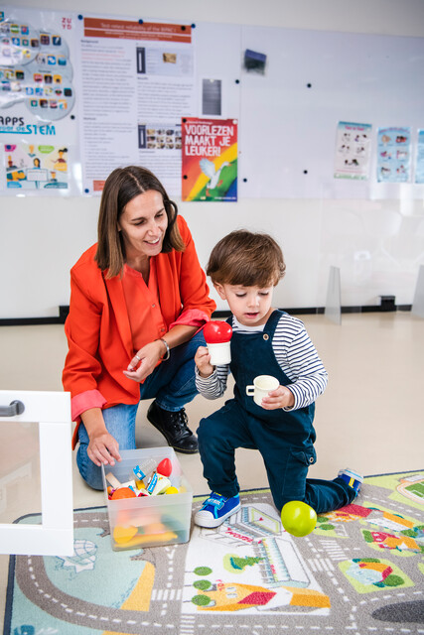
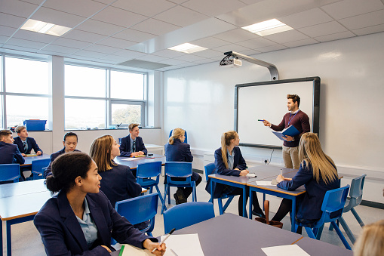
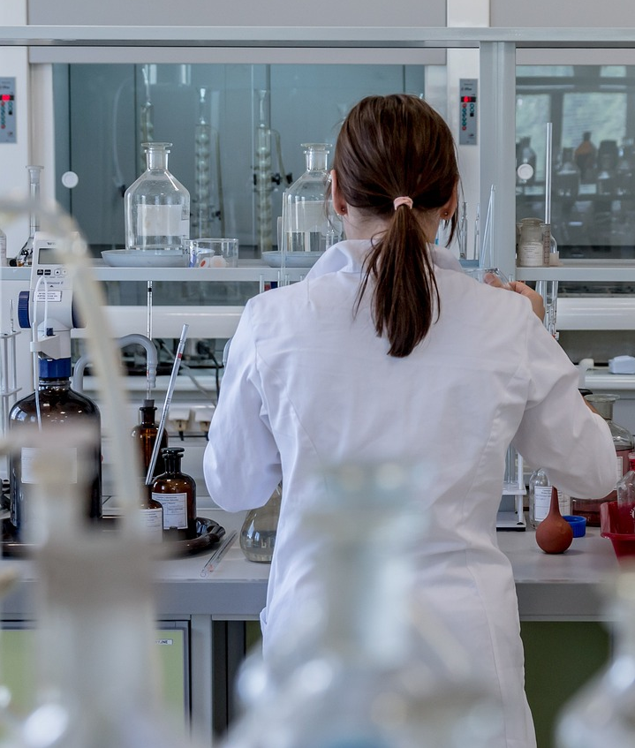
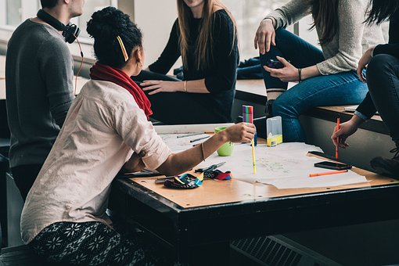
Innovaties in het Onderwijs
Notes:
The developments, ideas, and insights that come into vocational education are very diverse. Examples include new insights regarding the content of the profession being taught (e.g., new speech therapy treatment methods, analytical techniques in applied sciences), understanding how students learn best, effective lesson planning for active learning, designing assessments, guiding students effectively, group dynamics, new technological applications both in professional practice and education, and fresh perspectives on research skills.

Slide 8
Notes:
The question arises, though: How do educators cope with the fast-paced developments thrust upon them? What we see is that new ideas are launched like fireworks, grabbing attention for a brief period, and then many of these ideas or products fade away, and we return to our previous routines. This leads to a significant loss of time and energy. Teachers, who feel immensely responsible for their students' learning, strive to keep up with as many innovations as possible. This places a tremendous burden on educators.
Indeed, the quality of education largely depends on these "superheroes." They wield the greatest influence on the success of educational innovations. They determine what transpires in the classroom. Therefore, fostering educational innovation necessitates certain qualities and skills in teachers. This is known as Innovative Work Behavior (IWB).

Slide 9
Innovatief Werk Gedrag (IWB)
Opportunity exploration
Idea generation
Idea promotion
Idea realisation
Notes:
Traditional IWB comprizes four phases, each requiring different skills and behaviors from educators. The first phase is "opportunity exploration," which involves identifying opportunities for improvement. Then comes the "idea generation" phase, which demands skills to convert opportunities into concrete ideas. The third phase, "idea promotion," focuses on the ability to excite others about the idea. The fourth phase, "idea realization," involves transforming the idea into, for instance, new teaching materials and putting it into practice.

Slide 10
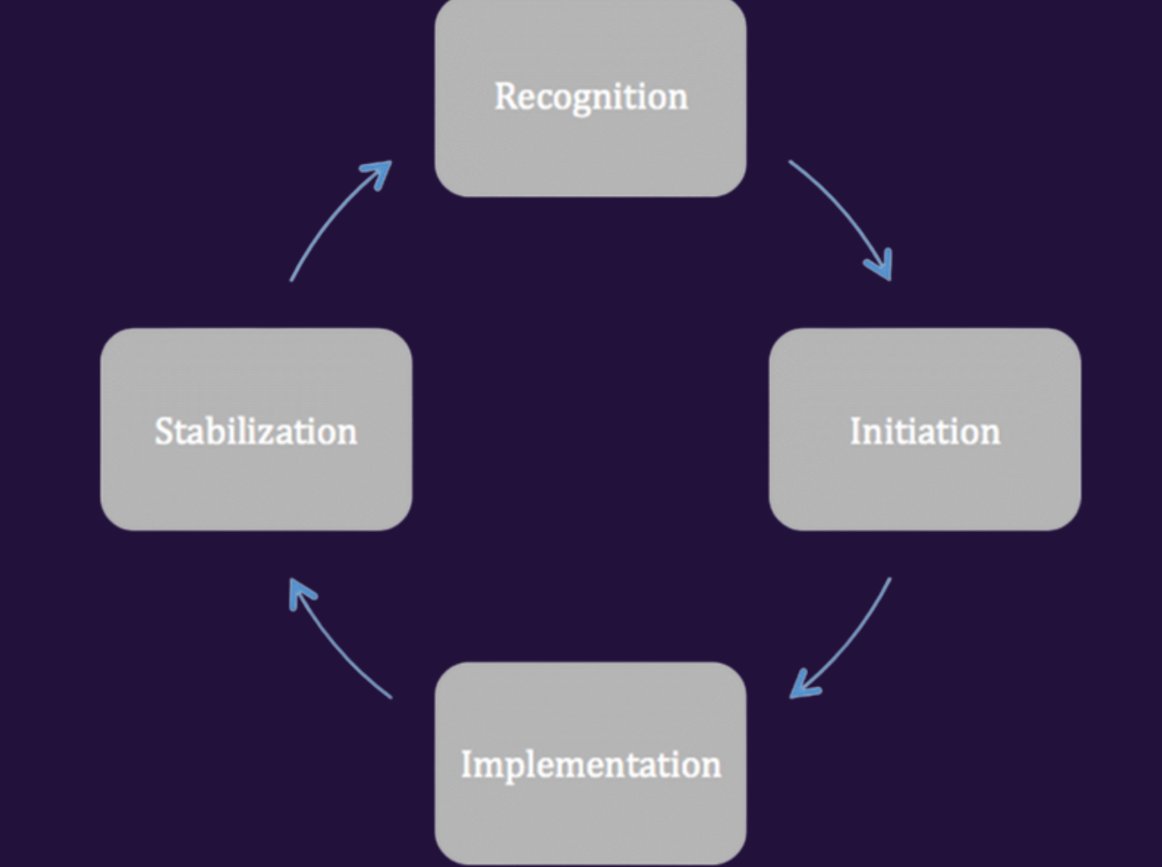
Innovationmodel vs. Innovative work behaviour (IWB)
Opportunity exploration
Idea generation
Idea Promotion
Idea realisation
West & Farr, 1989
Notes:
But, when comparing the traditional concept of IWB to common innovation models, such as the one proposed by West and Farr, something remarkable becomes evident. The four dimensions of IWB are represented in the first three phases of the innovation cycle. However, the concept of IWB lacks a dimension covering the stabilization phase. This phase implies that an idea or innovation is firmly integrated into an organization, and educators have incorporated it into their routines while adapting support systems accordingly.

Slide 11
Duurzame innovaties
Notes:
Nonetheless, it's observed in both literature and practice that many ideas fail to become integrated. Therefore, my research focuses on extending the concept of Innovative Work Behavior with a fifth phase, "idea sustainability," which pertains to the sustainable implementation of an idea, making it an inherent part of educators' DNA and routine.

Slide 12
Innovatief Werk Gedrag (IWB)
Opportunity exploration
Idea generation
Idea promotion
Idea realisation
Idea sustainability
Notes:
To gain a deeper understanding of the IWB concept and the conditions that encourage it among educators, I conducted four different studies.

Slide 13
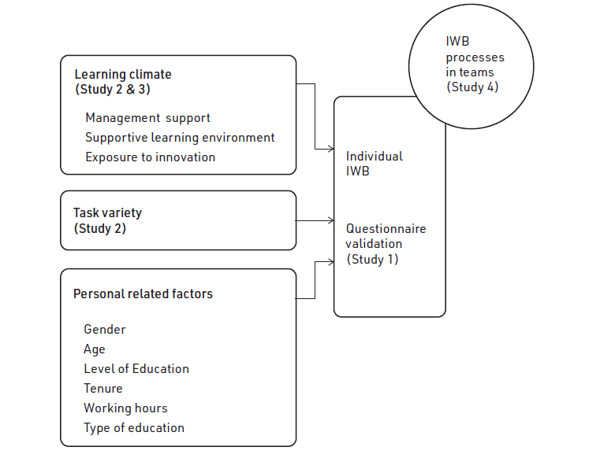

Slide 14
Succes Factoren
Aandacht voor Idea Sustainability
Leerklimaat:
Management support
Ondersteunende leeromgeving
Innovatie bereidheid/ readiness/ exposure
Team Samenstelling
Taakvariatie

Slide 15
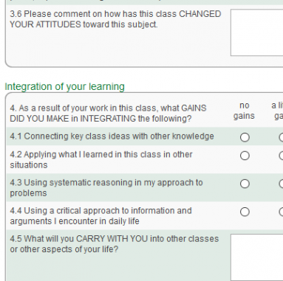
Vragenlijst
This Photo by Unknown author is licensed under CC BY-SA-NC.
Notes:
Traditional IWB comprizes four phases, each requiring different skills and behaviors from educators. The first phase is "opportunity exploration," which involves identifying opportunities for improvement. Then comes the "idea generation" phase, which demands skills to convert opportunities into concrete ideas. The third phase, "idea promotion," focuses on the ability to excite others about the idea. The fourth phase, "idea realization," involves transforming the idea into, for instance, new teaching materials and putting it into practice.

Slide 16
Tool

Slide 17
First step

Slide 18
Take home message
Notes:
Congres duurzamer beleven met onze tips

Slide 19
Follow up
Gegevens uitwisselen i.v.m. community
Maatje zoeken
Periode afspreken van re-meeting
This Photo by Unknown author is licensed under CC BY-SA-NC.

Slide 20
Peggy.Lambriex@zuyd.nl Professionalisering van het Onderwijs (zuyd.nl)
This Photo by Unknown author is licensed under CC BY.

Slide 21
